Slide 1

Welcome to the TGGS
UCAS and Future Pathways Parent Information Evening
Mrs Gale – Head of Sixth Form and Head of Year 13
Mr Endersby – Year 12 Tutor supporting Oxbridge and Healthcare applications
Sam Wenman – Outreach Manager – University of Bath
Niamh Braybrook – Student Recruitment Manager – Bath Spa University
Mrs Keen – Head of Year 12

Slide 2
Objectives and Overview of this evening
Provide information and resources to support you to support your young person, as they make big decisions about their next steps
University – the most popular and likely option
Why University
Demystifying University finance
An overview of how to search university courses
An overview of the TGGS University application process
Workshop on supporting personal statement writing
Specific information about competitive course applications
Information on Degree Apprenticeships and Gap Years

Slide 3
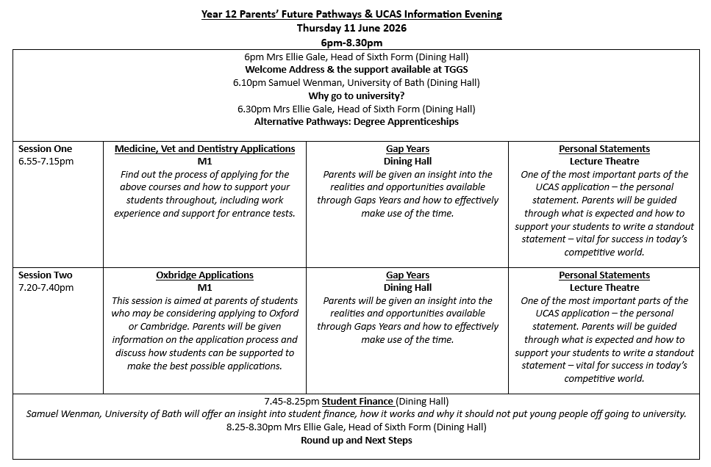

Slide 4
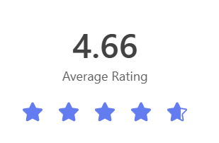
Year 13 Exit Survey - UCAS and Careers Provision:
How satisfied were you with the careers provision and UCAS support? 1-5, 5 being excellent

Slide 5
TGGS Support
Tutorial Programme - focus on encouraging super curricular skills throughout year 12. Also in the tutorial programme – Why Uni, Why Degree Apprenticeships, Oxbridge, Gap Years
Year 12 UCAS and Future Pathways Day: included talks on finance and personal statement writing workshops
Regular 1 to 1 mentoring with tutor and/or sixth form team
Independent Careers Advice
Subject specialists write subject references
Dedicated UCAS advisor / overall reference writer
Bespoke support for competitive courses and ‘other’ applications

Slide 6
Applying to University
Students will be starting to write their personal statements
Teachers are writing their subject references and entering predicted grades
Overall references will be completed in the Autumn Term by their reference writer
Students have started to complete their online UCAS application form today
Students will select the Universities they wish to apply for in the Autumn Term
Early entry applications will be sent in October
All other applications will be sent before Xmas (UCAS deadline is in Jan)
There is a £34.50 fee to apply
Students will the receive offers from their universities and will then receive guidance on how to choose their “firm” and “insurance” offers
Students will then make arrangements with their “firm” university choice regarding 1st year accommodation options
Families will have to arrange student finance separately

Slide 7
Choosing a Course and Finding out more
Subjects they love/enjoy. Consider their passions, interests.
Things they are good at
Specific career aspirations?
How far away from home?
Campus vs City uni
Unifrog and UCAS

Slide 8
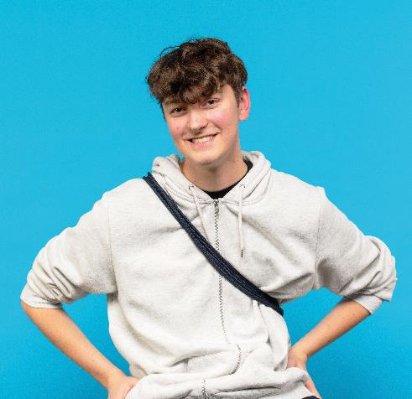
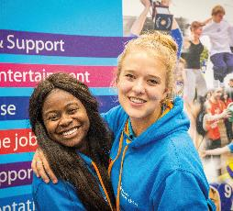

Why go to University
Sam Wenman
Widening Participation Outreach Manager

Slide 9
For undecided students - things NOT to consider (too much!)
Opinions of friends
Opinions – or likely destination of boyfriend/girlfriend
Opinions of family?
Opinions of teachers?
Instead: independent careers advice and/or lots of research!

Slide 10
Could university still be right for undecided or uncertain students?
Joint Honours – “and” vs “with”
Liberal Arts degrees - provide a broad-based education encompassing arts, humanities, and social sciences, offering flexibility and a multidisciplinary approach. Combine modules to reflect interests and aspirations
Placement year – “sandwich course”
Year abroad

Slide 11
Degree Apprenticeships
A degree apprenticeship enables students to gain a full undergraduate or master’s degree while they work.
Students spend most of their time working and they will also study part-time at university. For example, they might go to university one or two days per week, or in short blocks, such as a week at a time.
Overall, they spend about 20% of their time studying vs. 80% of their time working.

Slide 12
Benefits of a Degree Apprenticeship
Earn a full-time salary while studying – no need for student loans.
Gain valuable real-world work experience in a respected organisation.
Graduate with a full bachelor’s (or higher) degree – just like at university.
Get a head start in career with a professional network and on-the-job training.
Develop practical, job-specific skills that employers are actively looking for.
Avoid student debt – tuition fees are paid by the employer and the government.
Apply learning directly in a real job, making studies more engaging and relevant.
Stand out to future employers by showing commitment and strong work ethic.

Slide 13
How to get a degree apprenticeship
Research in Summer Year 12 and Autumn Year 13
Apply online – often includes a covering letter, CV or personal statement
Many larger employers will also require you to do online aptitude or psychometric tests, these may include: numerical reasoning, verbal reasoning, situational judgement tests (SJTs) o personality questionnaires
Often there is also a video interview, this may be live or they may send you questions and ask you to submit a pre recorded response within a short timeframe. Common questions: "Why this apprenticeship?“, "Why this company?“ "Tell us about a time you showed teamwork/leadership/problem solving.”
The next could be an invite to an assessment centre – online or in person. This stage typically includes: Group tasks, Case studies, and Presentations
If not part of the assessment centre, then a formal interview will often form the last piece of the application process

Slide 14
Researching Degree Apprenticeships
1. UCAS – The apprenticeships hub
2. GOV.UK – Find an Apprenticeship
3. Unifrog – degree apprenticeship search tool
4. www.amazingapprenticeships.com
Plus: employer pages!

