Slide 1
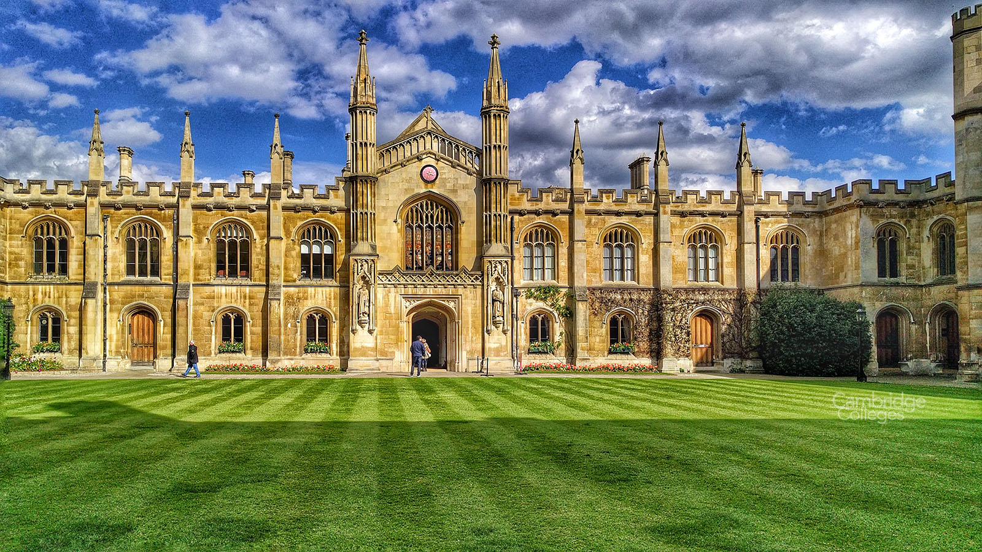



Oxbridge Advice 2026

Slide 2

Cambridge & Oxford – “early application”
1 of 5 uni/course choices on UCAS
  Can’t apply to both Oxford & Cambridge
Why? Stretching Individual focus Facilities Support Finance Status
Not right for everyone – course? Teaching style? Assessment? Intensity?
Collegiate universities – applications handled by individual colleges*
  Pool system reallocates strong students between colleges
College choice
  Size? Age? Location? Facilities? Vibe?
  But all teaching handled at uni dept level – so choice of
  college is not an academic decision*
Par is about 1 in 6 getting in – a good outcome would be 2 in 5
TGGS 2026: 9 applicants -> 3 offers
No magic – it’s quite a transparent process
Notes:
Lots of online support available - Don’t need to pay

Slide 3

PERSONAL STATEMENT
GCSE RESULTS
SCHOOL REFERENCE
INTERVIEW
TEST RESULTS?
PERSONAL CIRCUMSTANCES?
Written Work?
UCAS PREDICTIONS
Supplementary Questionaire
Notes:
Reference changing but will still be signif school written support

Slide 4
To plan towards…
Individual meetings with AJE to discuss aspirations, plan ahead
Year 12 Assessments, predicted grades
Supercurricular activities – what done? What to do?
Decision-making
  Course?
  Place – Oxford or Cambridge? Neither? Oxbridge College?
  Open Days
    Oxford - Wednesday 1st July, Thursday 2nd July and Friday 18th September
    Cambridge – Thursday 9th & Friday 10th July, Colleges only Friday 11th September
    May need to pre-book some visits, esp faculties, talks – travel and accommodation?
Test Prep – test? what test? Timings? Practice & support
Personal Statement & application
Interview prep
Notes:
Depts – reading – uni webinars/confrerences – competitions & Challenges – Moocs – visits – podcasts & videos - blogging, etc. Links good
Poss of minibus to Oxford, almost certainly not Cambridge

Slide 5
Timeline
Now -> end of summer term:
  Check likely predicted grades with staff
  Research and decisions – online, open days, discussion with AJE
  Continue super-curricular activities, esp reading, discussion groups
  Present on super-curricular topic of your choice in July
  Begin to look at test requirements & prep - Admissions tests | University of Oxford &
  Admission assessments | Undergraduate Study (cam.ac.uk)
  Personal Statement draft to AJE for end of term, feedback given
Summer break
  Super curricular incl work experience, reading, test prep, Moocs, etc. Develop p statement.
  LNAT reg 1st August-> LNAT | The Law National Aptitude Test + UCAT for Medicine
September – personal statement finalised & UCAS completed; enter for tests* & continue practice
October – 15th October UCAS deadline for submission with reference - but TGGS deadline end September.
Respond to requests for supplementary info &/or written work - test and interview prep.
Test Dates Cambridge & Oxford 12-16th October
- LNAT for Law sat 1st Sept to 15th October latest, UCAT by 24th September latest.
Interview prep workshop, practice questions
November - Mock interviews & feedback
December – Interviews (likely dates posted online in advance)
Mid-January – decisions released
Notes:
Don’t pay! - * test entry 1st to 29th Sept, 16th Sept latest for LNAT

